Slide 1
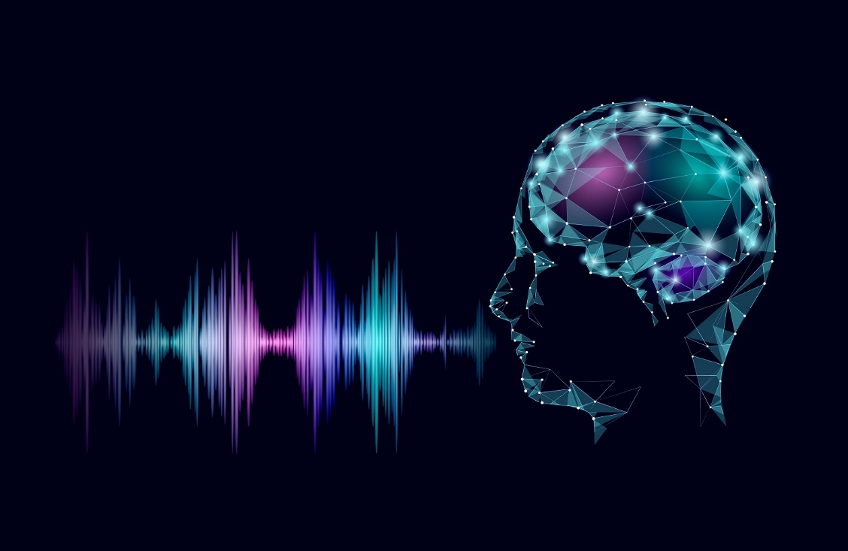
VIRTUAL INTELLIGENT PRESONAL ASSISTANT
DAVID

Slide 2
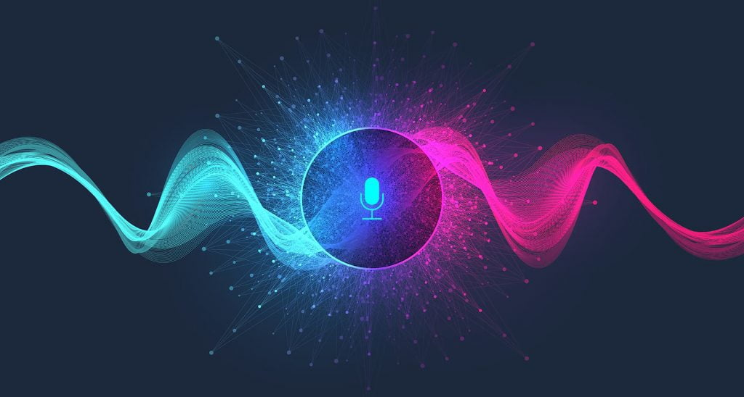
PRESENTATION ON
VIRTUAL INTELLIGENT PERSONAL ASSISTANT
GUIDED BY:
SANDHAYA M. PARDHI

Slide 3


Team Members
01
02
Lovely Sharma
Om Khandale
1915430221
1915430220

Slide 4

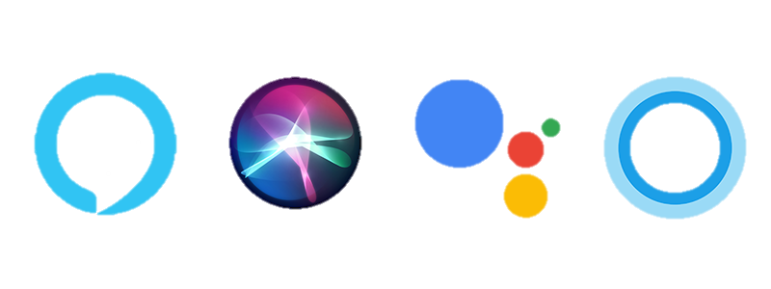
Preface
What is a Voice Assistant?
A voice assistant is a digital assistant that uses voice recognition, language processing algorithms, and voice synthesis to listen to specific voice commands and return relevant information or perform specific functions as requested by the user.
Who is David?
Purpose
Preface
Testing
Introduction
Modules
DFD’s
3 Layers
David is our personal voice assistant who does all the tasks which are performed by all other voice assistants and much more than the existing ones.

Slide 5
Voice assistants are programs on digital devices that listen and respond to verbal commands. They can make calls send text and they can also provide solutions to some complex computational problems.
It is a combination of several different technologies: voice recognition, voice analysis and language processing.
Purpose
DFD’s
Modules
3 Layers
Introduction
Testing
The attempt has been made to develop an “Intelligent Personal Voice Assistant using Python” which helps people to control device with their voice (speech), extract information and perform tasks on their desktop.

Slide 6
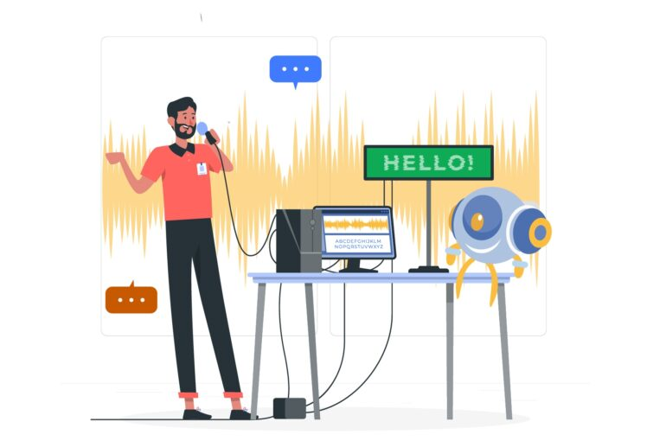
How does David works?
User asks a personal assistant to perform a task
The query asked by the user is processed as a string and based upon the task mentioned in the query the algorithm matches the query with its corresponding task and the Assistant executes the task and gives an acknowledgement to the user whether the task is performed or not.
The natural language audio signal is converted into digital data that can be analysed by the software compared with match case using an innovative algorithm to find a suitable response.
Working

Slide 7
The main objective of David is to reduce users manual interaction with the system and performing all those tasks using voice inputs only.
1
2
3
Purpose
Testing
Reduce manual interaction with the system
Perform tasks more efficiently
Solve complex computational problems
Introduction
Modules
DFD’s
3 Layers

Slide 8
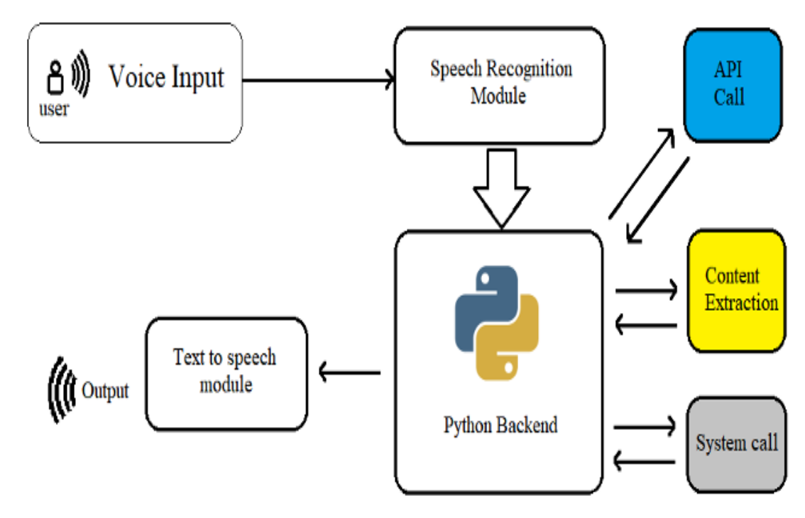
Working of System
David focuses on relieving voice as primary means of user input. Agent then applies voice recognition algorithms to this input and records the input. It then use this input to call one of the personal information management applications such as task list or calendar to record a new entry or to search about it on search engines like Google.
Design

Slide 9
Speech Recognition
Processing
output
2
4
Design
1
3
5
Voice Input
Match case
Executing Task

Slide 10



Purpose
Testing
Introduction
Modules
DFD’s
3 Layers
Speech to
Text
Text Analyzing
Interpret Command

Slide 11
Three working layers
Any virtual assistant basically consist of three layers
Speech to text
Text analysing
Interpret commands
Speech to text
A piece of software that is used to convert audio to text
It simply converts the speech to text and doesn’t understand anything
Text analysing
A piece of software converts text to something that is understandable for computer
Computer understands the command so virtual assistant like Siri converts this text to computer command
3 Layers
Interpret commands
In this layer the commands are mapped with their corresponding tasks
Example: Play music, Open notepad

Slide 12
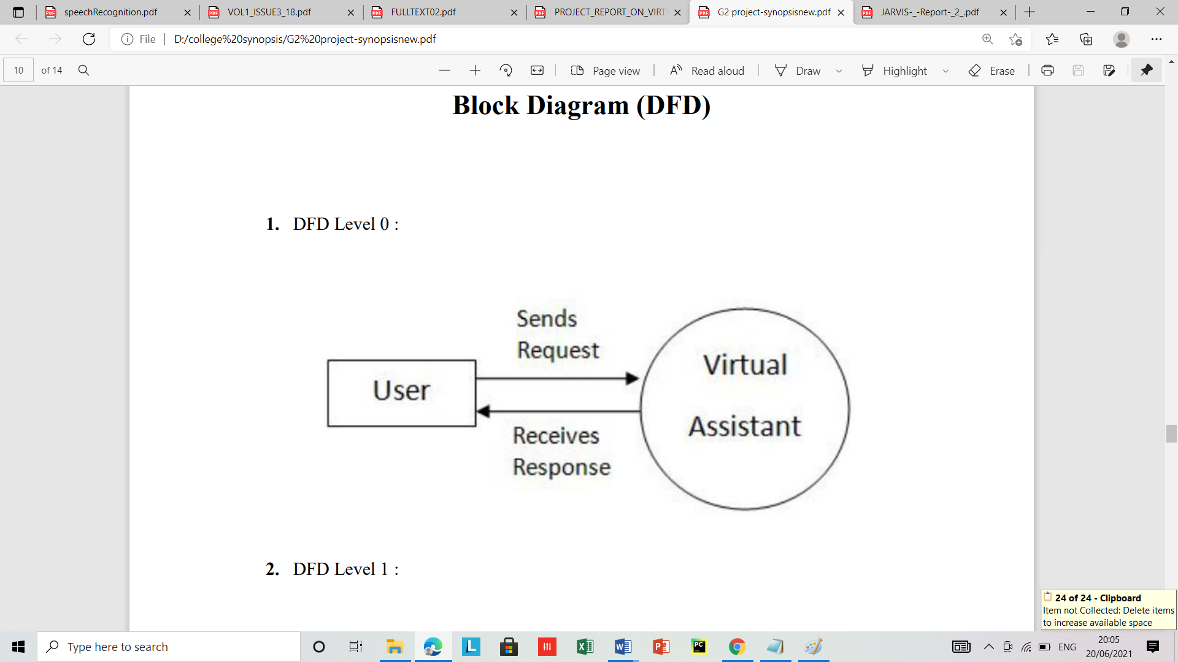
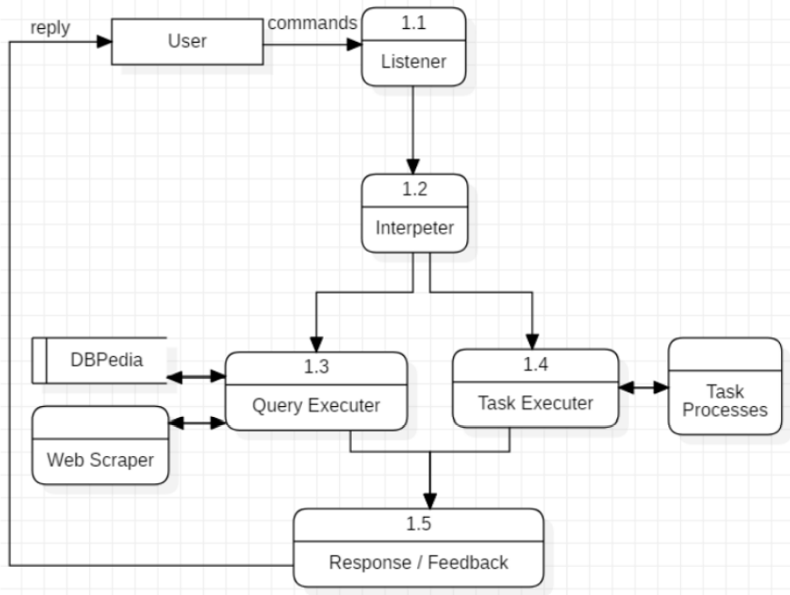
DFD Level 0
DFD Level 1
DFD’s

Slide 13
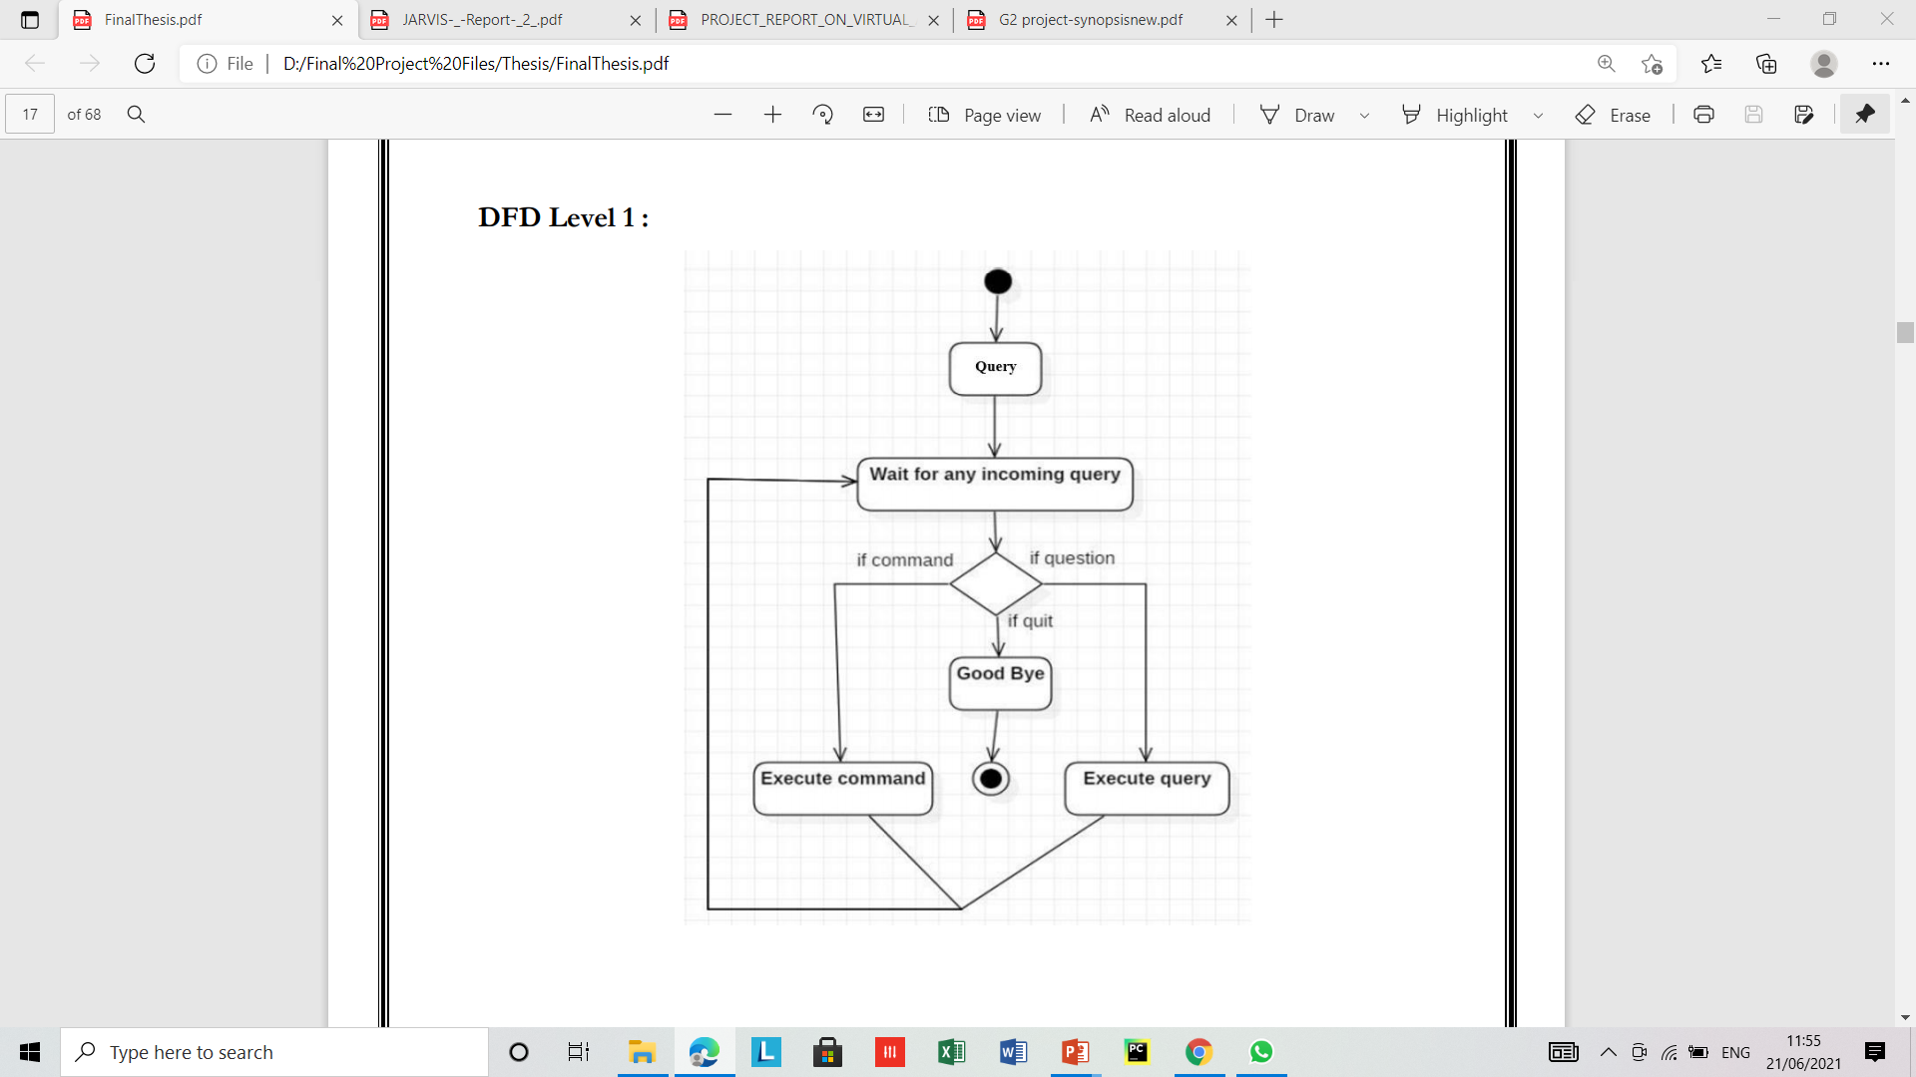
Flow Diagram:
DFD’s

Slide 14
Implementation
Once the user gives a command to the assistant the program first identifies the query and then it converts the query into string after that the assistant processes the query based upon the match cases provided.
For example if the user asks for “ current weather in Pune” the main part here is weather which is a type of information and the attached keyword is place, thus the match case for the query will be “weather” and the place for which we want the weather conditions is “pune”. Finally the assistant initiates an API call to fetch weather data for the city which user has demanded.
Weather in pune
27C
Recognizing input as string
Output in the form of speech
Implementation
Processing input
API
Processing output
Fetching data from weather API
Weather Data

Slide 15
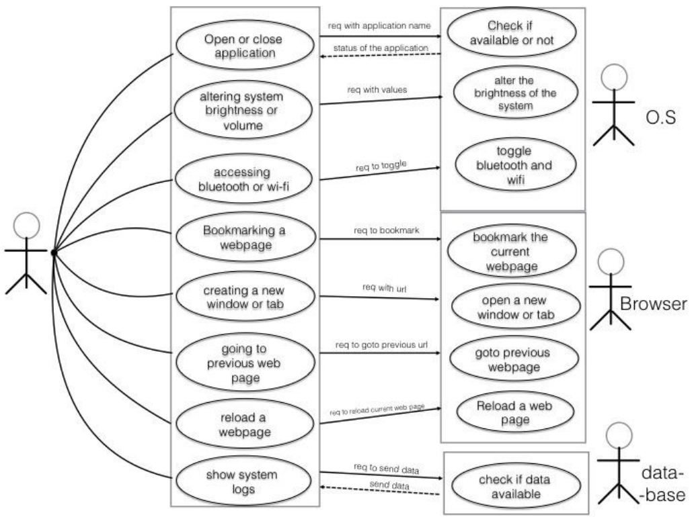
Use Case Diagram
Use Case

Slide 16
1
Speech Recognition
4
Wikipedia
This is for recognizing the user query in the form of text
To scrape article form Wikipedia
Pyttsx3
Psutil
Purpose
Testing
2
5
Modules
Introduction
DFD’s
This module converts text into speech form
For tracking dealing system information
3 Layers
WolframAlpha
6
os
3
for managing system related tasks
This is an API for complex computational problems

Slide 17
S/W
H/W
Purpose
history
3 Layers
services
DFD’s
teams
about
Modules
Introduction
timeline
Windows 7(32-bit) or above.
Python 3.9.1 or later
Pycharm Community Edition 2020.3
Ram: 1Gb minimum
Storage: 2GB Recommend.
CPU:I3 5th Gen Recommend
Requirements

Slide 18
Testing
Test Case 2
Test Case 3
Test Case 1
Accuracy
To assure that answers retrieved by system are accurate as per gathered data.
Connectivity
To check proper network connectivity to the internet
Response Time
To make sure that the system respond back time is efficient.

Slide 19
Development life cycle
Development
25%
25%
50%
100%
Requirement gathering
Design & implementation
Testing
Deployment
Week1-Week2
Week3-Week6
Week7-Week10
Week11-Week12

Slide 20
Features
Internal Commands
Scraping data
General Response
Features
Opening system applications
Scraping Wikipedia articles and Google results
Responding to user with general question and answer

Slide 21
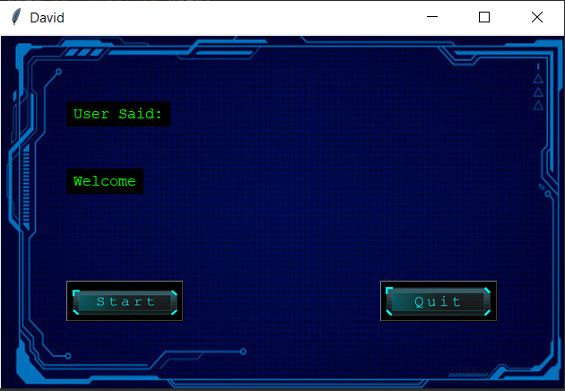
Snapshots

Slide 22
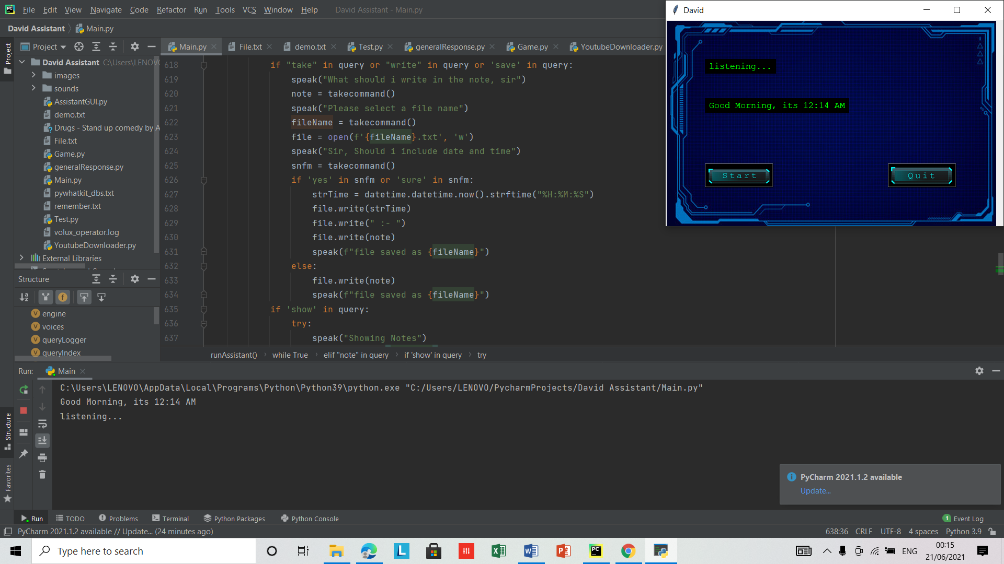
Snapshots

Slide 23

Snapshots

Slide 24

Snapshots

Slide 25



Future scope
We plan to Integrate David with mobile using react native, to provide a synchronized experience between the two connected devices. Further, in the long run, David is planned to integrate with online server to make it more lightweight application for all the platforms and make it cross platform application. David is planned to be integrated with AI and ML for integrating the training mode. This Intelligent Voice Assistant has an enormous and limitless scope in the future. Like Siri, Google Now and Cortana most popular personal voice assistants. The project will easily able to integrate with devices near future for a Connected Home using Internet of Things, voice command system and computer vision.
Purpose
Scope
3 Layers
Snapshots
DFD’s
Modules
Introduction
Requirements
8M
6M
7M
Add Some Brief Text Here to Explain
Add Some Brief Text Here to Explain
Add Some Brief Text Here to Explain

Slide 26
Conclusion:
The personal voice assistant system presented in this project is very fundamental system with few features however the additional and advance feature may be introduced as future work of this project, in this report the design and implementation of an Intelligent Personal Voice Assistance is described.
The project is built using available open source software modules with pycharm code community backing which can accommodate any updates in future. Speech recognition technology is a key technology which will provide a new way of human interaction with machine or tools.
Conclusion
However, there are also several problems with the currently available voice assistant products. Privacy and security controls will need to be improved before voice assistants should be used for anything that requires confidentiality.

Slide 27

Questions

Slide 28

THANK YOU !

